Slide 1
SWACHHATA HI SEVA
Swachhata hi seva drive was observed on 29 Sep 2018 in presence of Shri Sanjay Singh Sr. GM (HR & Admin) HEG Ltd, Mandideep, a unit of Bhilwara group.
During the awareness programme, message of importance of cleaning among the society was spreaded and carried out cleaning of surroundings and inside as well.
Here are the glimpses

Slide 3
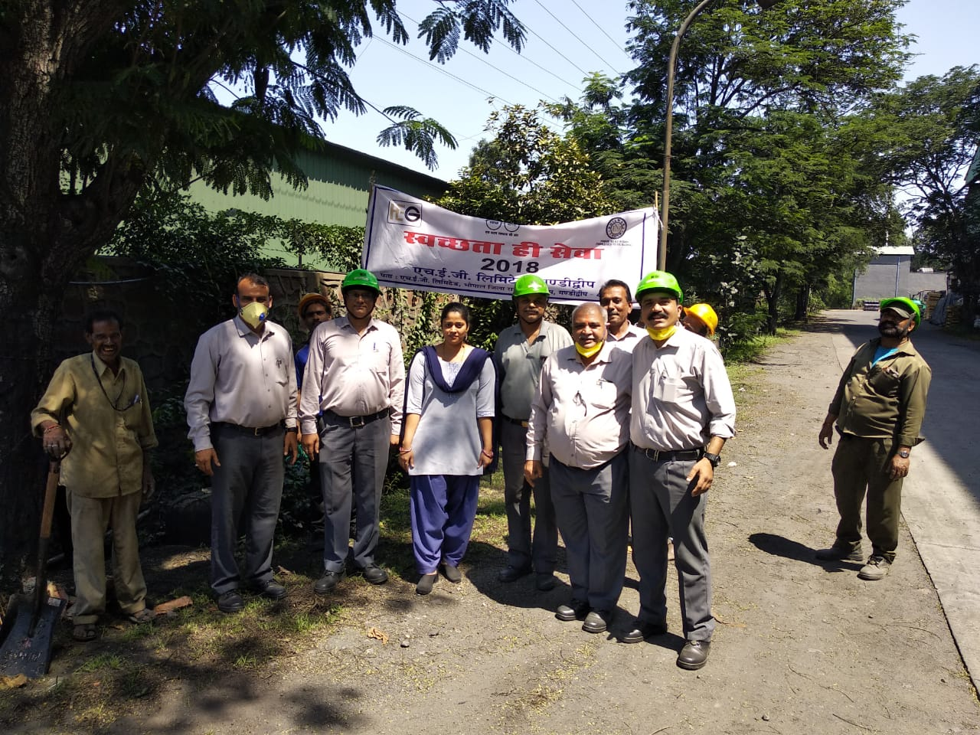

Slide 4
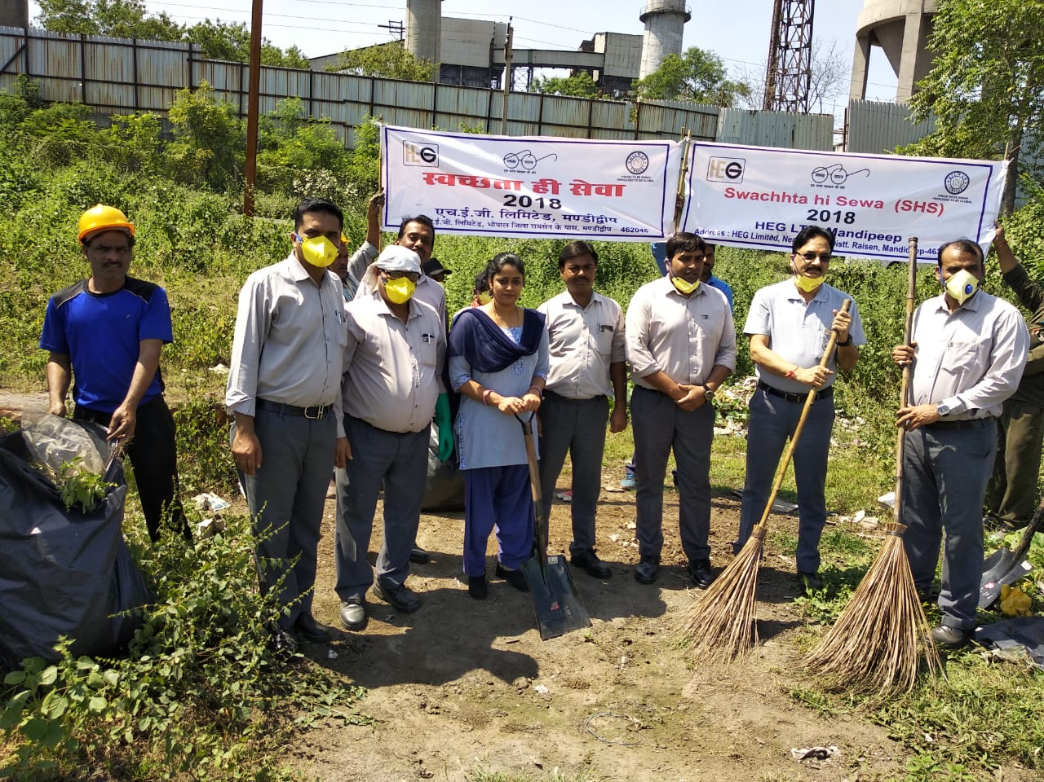
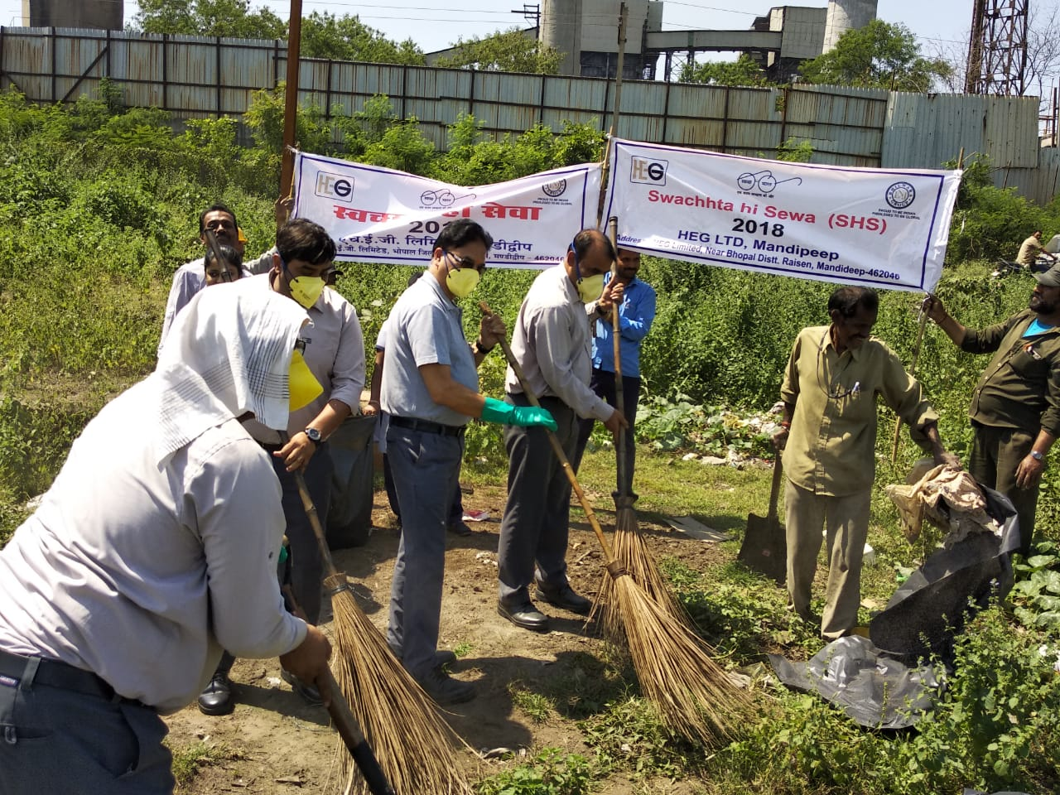
Cleaning of surroundings

Slide 5
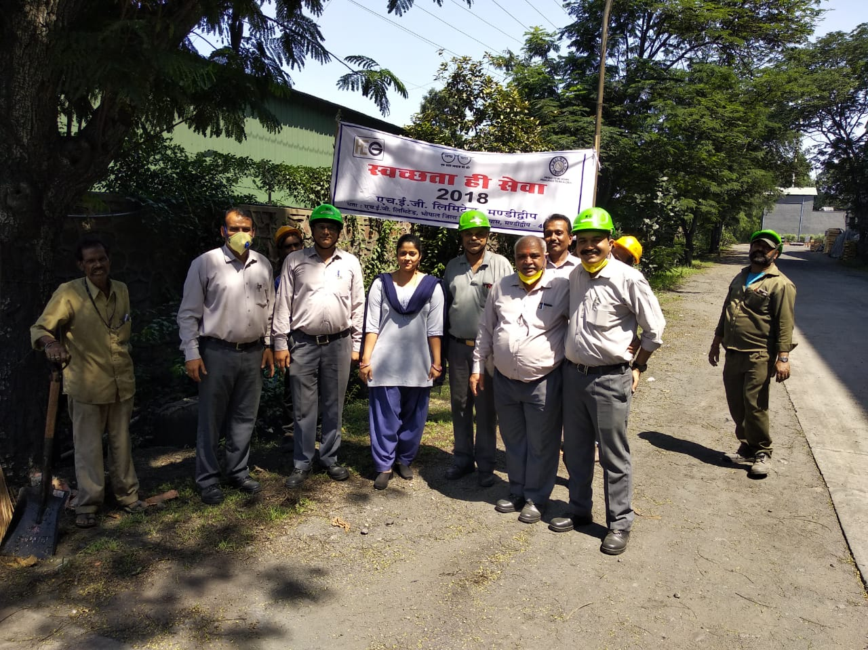
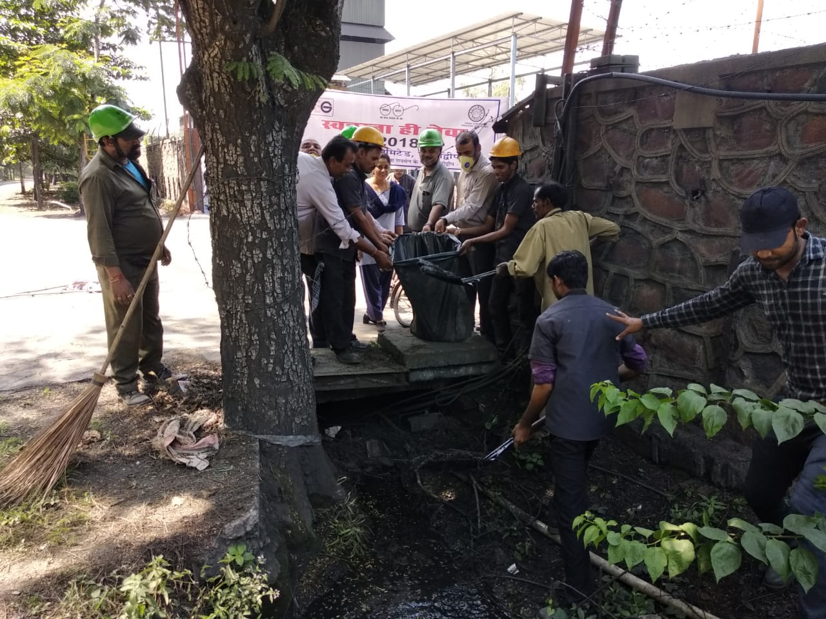
Cleaning of drainage

Slide 6
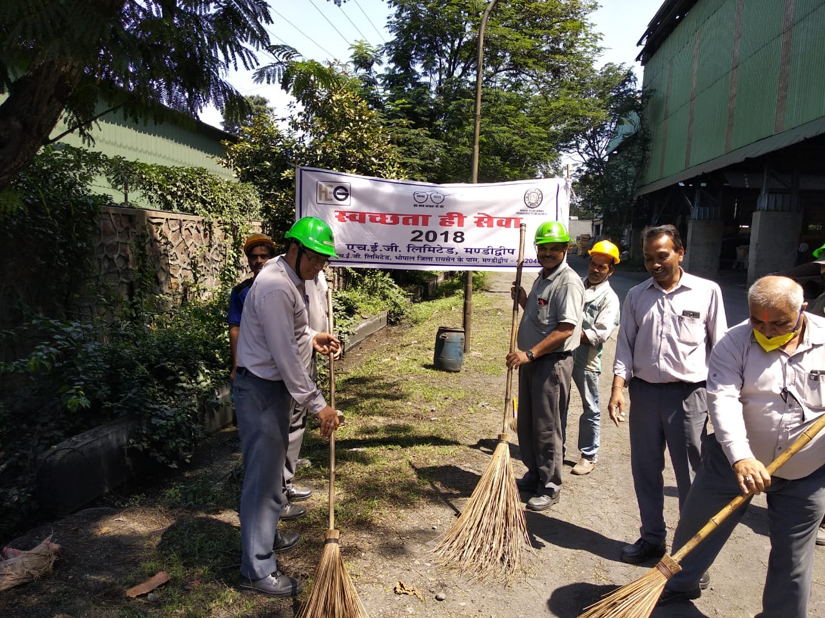
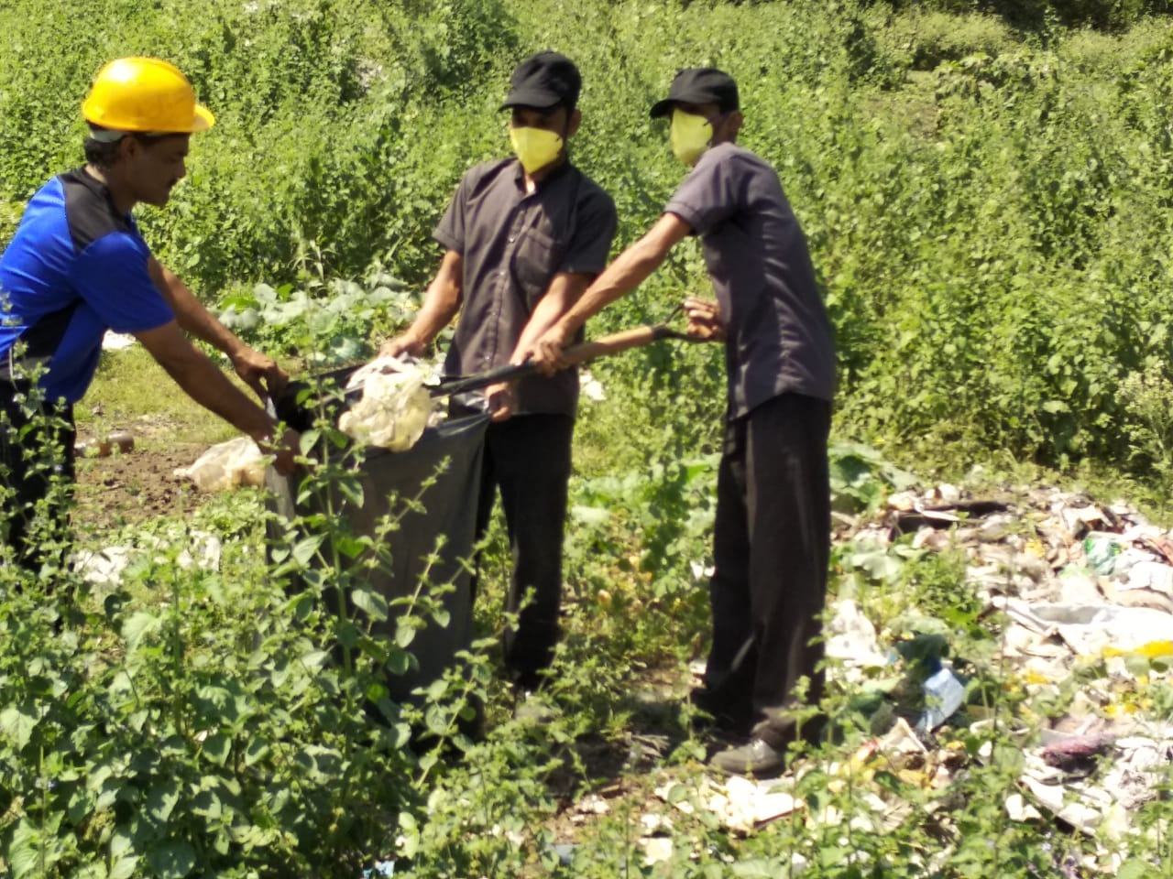
Cleaning activities

Slide 7
THANKS

